Slide 1
IT Service Management
Presentation
Tarak Hasan

Slide 2
Overview
Discussing the importance of Service Level Management (SLM) to an IT Service Provider.

Slide 3
Key Points
Overview
Importance of SLM to IT Service Providers
Significance of SLA Metrics
Challenges and Risks Associated with SLM
Example of SLA Implementation (Case Study)
Microsoft SLA performance Reports
Recommendations & Conclusion

Slide 4
Importance of SLM to IT Service Providers
SLM manages service levels via SLAs and SLOs to meet business needs & goals. Ensures cost-effective service delivery and high service quality.
Essential tasks: Define business requirements, control IT services, and manage SLAs. Regular monitoring and reporting on SLA compliance to improve services.
Benefits: Increases transparency, clarifies customer expectations, and boosts satisfaction. Helps optimize resources, reduce risks, and acquire new customers through quality service.

Slide 5
Significance of SLA Metrics
SLA metrics measure service performance and align with business goals.
Common metrics: Availability, Mean Time to Recovery (MTTR), Response Time, Error Rates, and Compliance.
Direct Metrics: Measured from resources like servers or applications (e.g., system diagnostics, network performance).
Composite Metrics: Average multiple metrics over time, such as average availability or maximum response time.

Slide 6
Challenges and Risks Associated with SLM
Inconsistent Metrics – Hard to standardize, causing mismatched expectations. (Solution: Define clear, realistic metrics.).
Miscommunication – IT and business teams may not align. (Solution: Regular meetings and collaboration.).
Overloaded SLAs – Too many agreements make tracking difficult. (Solution: Focus on critical SLAs.
Lack of Improvement – Outdated SLAs fail business needs. (Solution: Regular reviews and updates.)
Risks – Poor change management, manual errors, and shadow IT impact performance. (Solution: Automate, monitor KPIs, and enforce security.)

Slide 7
Example of SLA Implementation
Case Study: A multinational corporation with over 50,000 employees adopted Microsoft 365 and Azure to streamline collaboration, security, and cloud computing. The company needed to ensure high availability, compliance, and performance guarantees, making Microsoft’s Service Level Agreements (SLAs) a critical component of their IT strategy.
Incident Response & Resolution Times(Microsoft):
Azure Rapid Response: 15-minute response for Severity A issues.
Other Azure Plans: Less than 1-hour response for critical issues.
Microsoft 365 & Dynamics 365: Under 1-hour response for major support plans.
Service Availability:
99.9% uptime guarantee for core services (VMs, storage, databases).
Defines service availability in Microsoft's SLA.
Allows minimal downtime (43.8 min/month, 8.77 hrs/year).

Slide 8
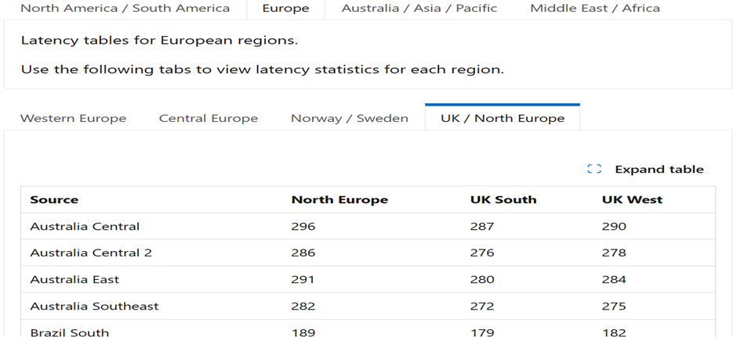
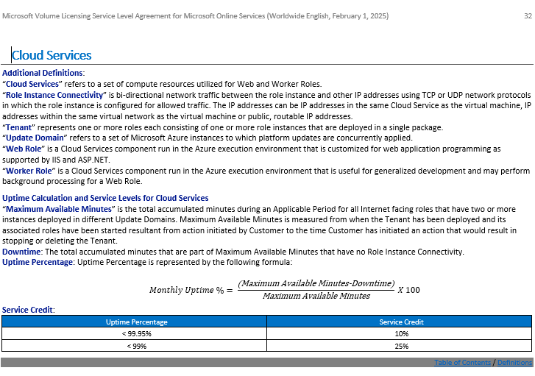
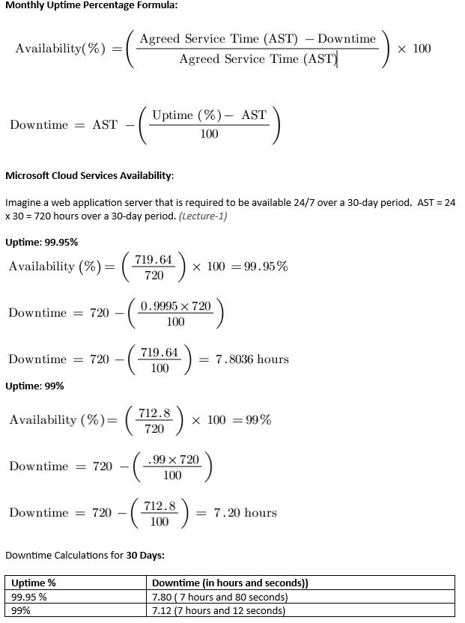
Performance Report
Performance & Compliance Metrics Microsoft SLA(Online services) Feb 1,2025

Slide 9
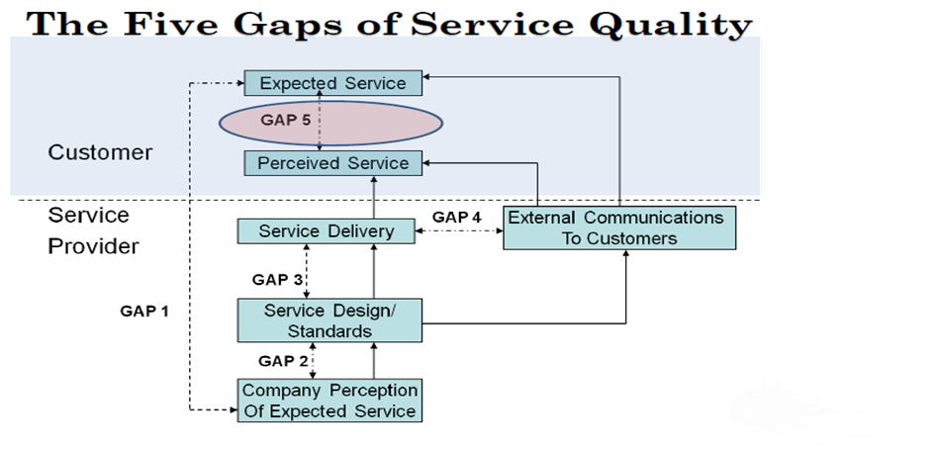
Handling SLA Violations (Penalty)
Gap 4 (External Communication Gap) in the SERVQUAL Model occurs when actual service delivery does not meet advertised promises.
Microsoft's 99.99% uptime promise was not met, with actual performance at 99.95% and 99%, leading to SLA breaches.
Service credits (10%–25%) were issued, causing financial loss, customer dissatisfaction, and reputational damage.

Slide 10
Recommendations & Conclusion
Conclusion:
SLM enhances service quality, reduces risks, and aligns IT services with business needs. Regular reviews and flexible SLAs ensure continuous improvement.
Key Recommendations:
Align SLAs with business goals and review them regularly.
Use AI and automation for proactive SLA management.
Maintain clear communication and consistent metrics.
Implement flexible SLAs to adapt to changing needs.

